Slide 1
Chapter 5 MICRO-SEQUENCER CONTROL UNIT DESIGN

Slide 2
Contents:
Basic Micro-sequencer (Control Unit) Design and Operations
Micro-instruction Formats
Design and Implementation of a Very Simple Micro-sequencer
Control Unit: Layout, Control Sequence Generation, Mapping Logic
Generation of Micro-operations using Horizontal and Vertical Microcode
Directly generating the control signal from the Microcode
Reducing tile Number of Micro-instructions
Micro-programmed Vs Hardwired Control Unit

Slide 3
5.0 Introduction to Micro sequencer
Hardwired control is one of the two most commonly used control methods.
The another popular control method is the micro-sequencing.
Instead of generating the control signals using combinational and sequential logic, a microsequencer stores its control signals in a lookup ROM, the microcode memory.
By accessing the locations of the ROM in the correct order, the lookup ROM asserts the control signals in the proper sequence to realize the instructions in the processor’s instruction set.

Slide 4
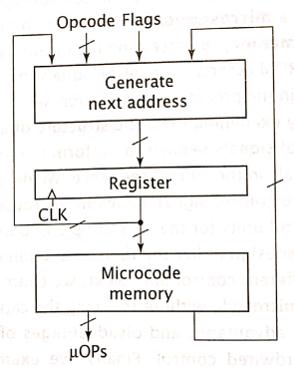
5.1 Basic Microsequencer (CU) Design and Operations
Like in hardwired control unit, a microsequencer is also designed as a finite state machine.
The microprogram sequencer is a general-purpose building block for the microprogrammed control unit.
The main objective of the microprogram sequencer is to demonstrate an address to the control memory so that microinstruction can be read and executed.
The next address logic of the sequencer decides the particular address source to be loaded into the control address register (CAR).
The figure shows the layout of the simple microsequencer.
Generic microsequencer Organization

Slide 5
Generate Next Address: This block typically generate all possible next address and then select correct next address to pass to the register.
One possible value of the next address is the current address + 1.
Another possible address is an absolute address supplied by the micro-code memory
REGISTER: stores a value that corresponds to 1-state in the CPU state diagram.
It serves as the address i.e. input to the micro-code memory.
MICRO-CODE memory: outputs a micro-instruction (the content of memory location for this address). Collectively, all of the microinstructions comprise the microcode, or microprogram, for the CPU. It consists of micro-instructions.
MICRO-INSTRUCTION: consists of several bit of fields which can be broadly classified into two groups:
micro-operation that generates the control signal.
Sequencer is used to generate the next address to be stored in the register.
Generic microsequencer Organization

Slide 6
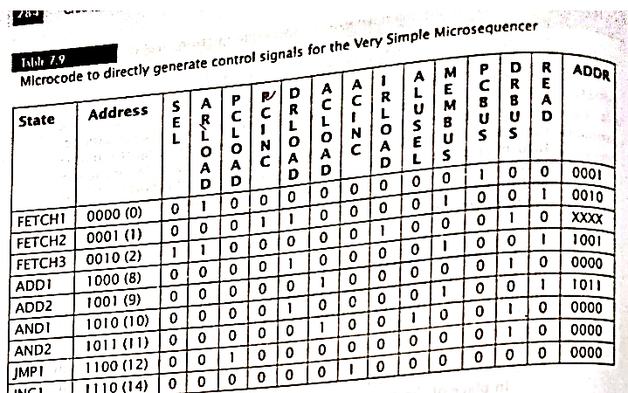
2.5 Micro-instruction formats
SELECT | MICRO-OPERATIONS | ADDR
Each micro-instruction in the Microcode memory consists of :
SELECT field: determines source of address of next microinstruction. It doesn’t specify the actual address, but only the source of the address.
ADDR field: specifies an absolute address. Used when performing absolute jump. => Microinstructions that specify another source for the next address, such as mapping address do not use bits of this field.
MICRO-OPERATIONS field: three primary methods.
horizontal microcode
vertical microcode
Direct generation of control signals
Example:

Slide 7
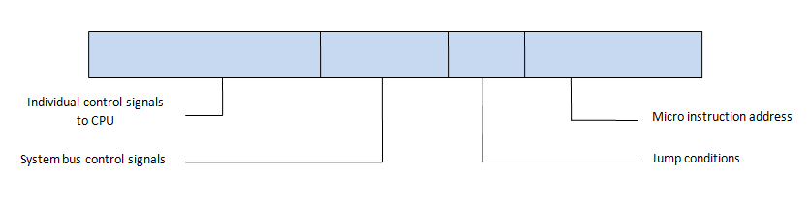
a) Horizontal Microcode
Figure: Horizontal microinstruction format
In horizontal micro-instruction, each control signal is represented by a single bit in the control word.
Thus, if the design has 500 control signals, it requires 500 bits in each control word to store the control bits.
In this format, the control store looks horizontal in shape, since the control words are wide.
The format of the horizontal instruction is as:
One bit for each internal processor control line
One bit for each system bus control line
Condition bit for flags
Address field
Advantage: Fast operation as the control signals will be ready as soon as the control word is fetched form the control store.
Disadvantages: The control word occupies more space of the control store.

Slide 8
a) Horizontal Microcode
Firstly, Listing every microoperation performed by CPU (mnemonics are used).
Assign one bit in the microoperations field of microinstruction to each microoperation. This will result in large microinstruction.
For example:
If a CPU performs 50 different microoperations, the micro-operation field uses 50 bits for every micro-operation.

Slide 9
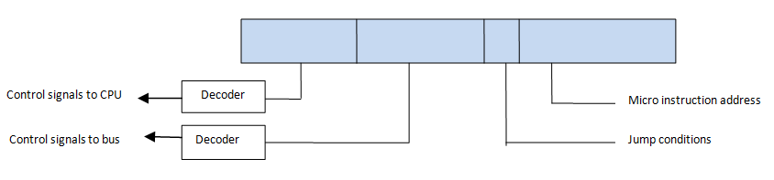
b) Vertical Microcode
Figure: Vertical microinstruction format
A vertical micro-instruction format is quite similar to the horizontal micro-instruction. It also consists of four fields:
Microinstruction address field
Condition field
Control signals to CPU
Control signals to system bus
Here, the difference is that: instead of a single 1-bit for each element, a code is used for each action to be performed. However, a decoder is used for translation of these codes into individual control signals.
These are more compact than the horizontal microinstruction. Hence, called vertical since the width is reduced.
For eg: for each 16 ALU operations, 16 individual bits are required in horizontal micro-instruction. But only 4 encoded bits are used in vertical micro-operation.
Advantage: shorter width of control word
Disadvantage: slower implementation

Slide 10
b) Vertical Microcode
The number of bits in micro-operation filed can be reduced by using vertical micro-code.
In vertical microcode, the micro-operations are grouped into fields.
Each microoperation is assigned a unique encoded value in this field.
For example:
16 microoperations can be encoded using 4 bits, from 0000 to 1111.
Vertical microinstruction require fewer bits than their equivalent horizontal micro-instructions. However, micro sequencers that use vertical microcode must include a decoder for each micro-operation field to generate actual micro-operation signals.
In both horizontal and vertical microcode, the CPU must convert micro-operation signals to the control signals that load, clear and increment registers, enable buffers and select the functions to be performed by ALU.

Slide 11
5.3 Design and Implementation of a Very Simple Micro-sequencer
To illustrate the process of microsequencer design, let us consider the very simple CPU that was developed in the previous chapter.
We redesign this CPU ,this time using a microsequencer instead of hardwired control.
The instruction set, finite state machine, data paths and ALU are the same.
Reference

Slide 12
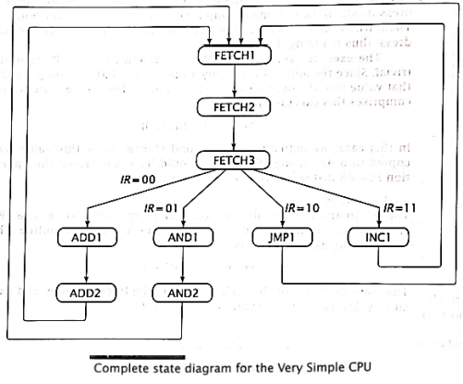
5.3 Design and Implementation of a Very Simple Micro-sequencer
Here, only two possible next address are used:
i) the opcode mapping and
ii) Absolute jump.
The last state of fetch cycle, fetch 3, goes to one of the 4 execute routines (ADD, AND , JMP, INC). This is implemented by mapping input.
The remaining states , each must go to one specific next state, which is implemented by using an absolute jump.

Slide 13
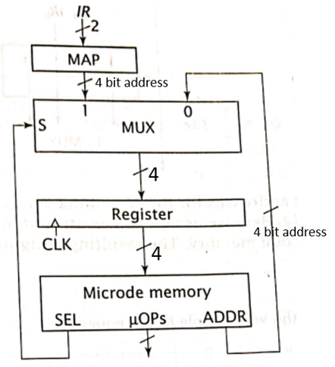
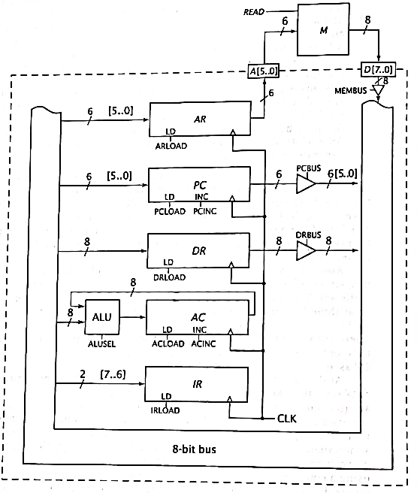
5.3 Design and Implementation of a Very Simple Micro-sequencer
Since, there are two possible addresses, the micro-sequencer must select one of them. So, there is a multiplexer to do this.
The select bit is generated by microsequencer to choose the correct next address.
The minimum number of bits needed to select is 4, which is the size of absolute address (because for our CPU, a total of 9 states are there).
The mapping hardware also generates an address of 4 bits wide.
The output of multiplexer is also 4 bits that is input to register and
output of register that is input to address inputs of microcode memory.

Slide 14
5.4 Control unit :
Layout, Control Sequence Generation, Mapping Logic

Slide 15
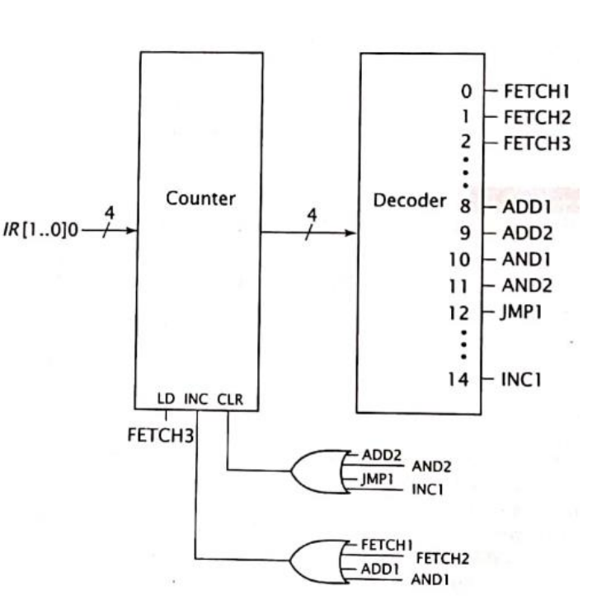
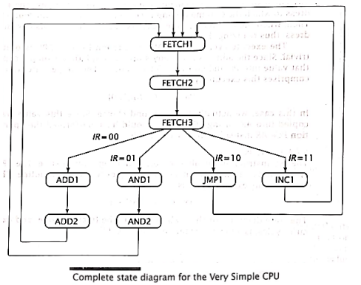
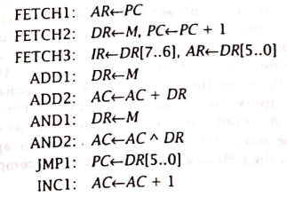
Consider below state diagram and Hardwired Control Unit for a relatively small CPU (from previous chapter).
RTL code

Slide 16
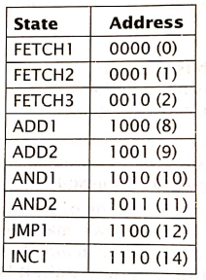
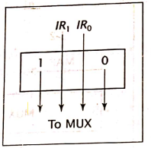
For this CPU, the micro-sequencer use the same mapping function that was used for hardwired control unit. 1 IR[1..0]0
This produces address of 1000, 1010, 1100 and 1110 (8, 10, 12 and 14) for ADD1, AND1, JMP and INC1.
The address for remaining states can be assigned somewhat randomly. Here we assign consecutive states to consecutive location in microcode memory (control memory)

Slide 17
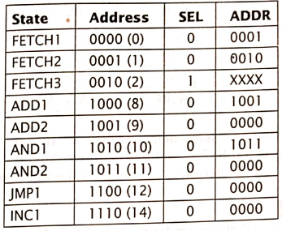
To go from Fetch1 to Fetch2, SEL=0 and ADDR=0001
Setting SEL=0 causes micro-sequencer to get its next address from ADDR field;
and setting ADDR field to 0001 causes it to go to location corresponding to state Fetch2.
But Fetch 3 must map to correct execute routine.
So, it requires SEL=1 to select mapping address.
Now, the contents of ADDR field are not used in microinstruction, it does not matter what value it has.
Partial Microcode for the very simple microprocessor

Slide 18
5.5 Generation of Micro-operations

Slide 19
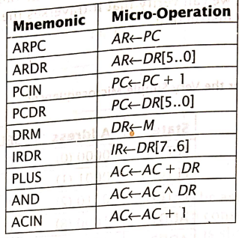

i) Generating the micro-operations using Horizontal Microcode
Microsequencer has two tasks:
i) to generate the correct micro-operations, and
ii) to follow the correct sequence of states.
One task is complete.
Now, the other task is to generate correct micro-operations, and associated control signals. This can be done by horizontal microcode or vertical microcode and Direct generation of control signals.
In horizontal microcode, each microoperation is represented by one-bit in each micro-instruction. The greater the number of microoperation, the larger the microcode will be.
The microoperations and their mnemonics are:

Slide 20
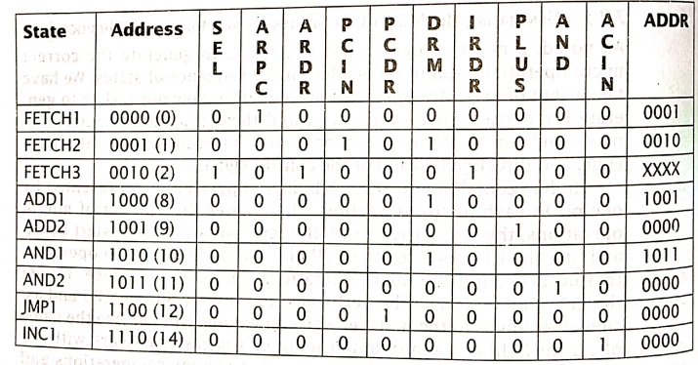
Horizontal Microcode
Since there are 9 micro-operations, each word of microcode requires 9 bits to represent them, 1 bit per micro-operation.
A value of 1 means the micro-operation is to occur and a value of 0 means that it does not.
To complete the microcode, we simply fill in the values for micro-operations.
The resultant microcode is shown in table aside (below).
References

Slide 21
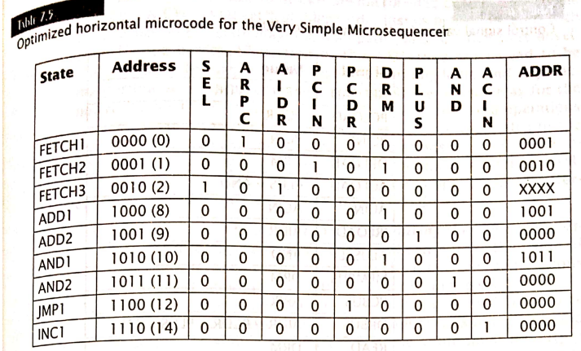
Horizontal Microcode
Here, for all the states, ARDR and IRDS have the same value.
So, we can use one output to drive both micro-operations.
Hence, we use AIDR that combines both operations AR←DR[5..0] and IR←DR[7..6]
References

Slide 22
Summary:
2. Let us assume the mnemonics for all the involved micro-operations as below:
4. Here, for all the states, ARDR and IRDR have the same value. So, we can combine these two control signals to a single menmonic as AIDR.
The optimized microcode for our CPU stored in Microcode memory is:
1. The State diagram and RTL code for our derived CPU are as below:
3. Now, the preliminary microcode for our CPU is:
5. The logic implementation of our required micro-sequencer Control Unit with horizontal microcode is as below:

Slide 23
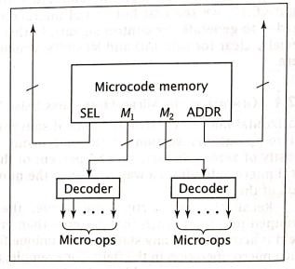
ii) Generating Micro-operation using Vertical Microcode
Vertical microcode reduce the number of bits in section of microcode.
In vertical microcode, the microoperations are grouped into fields such that no more than one microoperation in a field is active during any state. Then a unique value is assigned to each microoperation in the field.
For eg, a field with 8 (i.e. 2³=8) different microoperations would require 3 bits each value from 000 to 111 would be assigned to one of the eight microoperations. The microoperation field bits are output from microcode memory to a decoder.

Slide 24
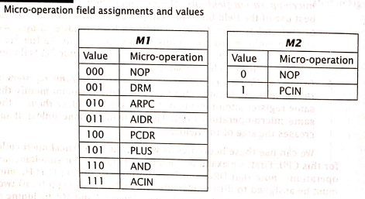
When two microoperations occurs during the same state, assign them to different fields.
For eg, DRM and PCIN both occur during Fetch2 states. So, must be assigned to different fields, one in M1 field and other in M2
Include a NOP (No operation ) if necessary, when no microoperation is active.
Group together micro-operation in same field that modify some register.
The CPU requires at least two fields for its microoperation labeled as M1 and M2.
References

Slide 25
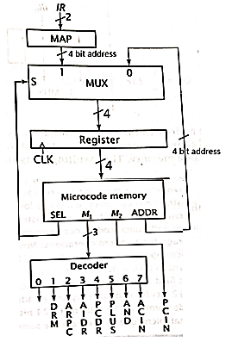
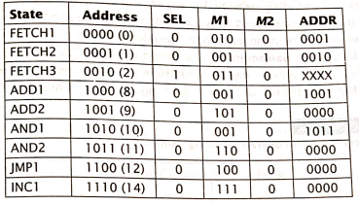
References
Vertical Microcode for the Very Simple Micro-sequencer
Fig: Logic Implementation for Micro-sequencer CU with vertical microcode

Slide 26
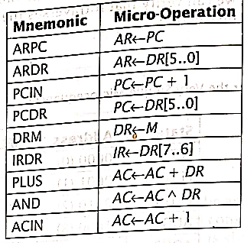
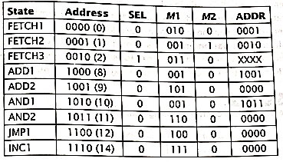
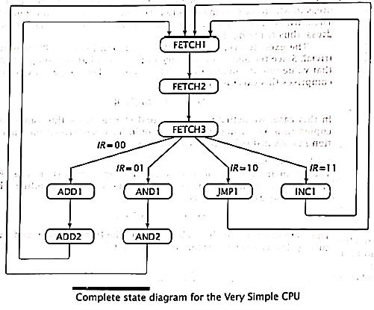
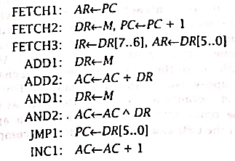
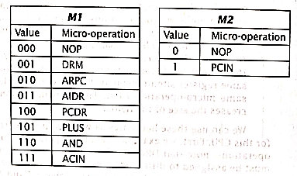
Summary:
2. Let us assume the mnemonics for all the involved micro-operations as below:
4. The two vertical microcodes for our CPU stored in Microcode memory is:
1. The State diagram and RTL code for our derived CPU are as below:
3. In Fetch 2 and Fetch 3, there are double operations.
If there are two operations in a single state, we require to make two vertical microcode represented in binary form.
Unused microcode are represented by NOP
Here, IRDR and ARDR are two operations to be performed simultaneously. Hence, this is represented as AIDR and included in M1.
Fig: Vertical Microcode for the Very Simple Micro-sequencer
5. The logic implementation of our required micro-sequencer Control Unit with vertical microcode is as below:

Slide 27
iii) Directly generating the control signals from the Microcode
Instead of outputting micro-operations form the microcode memory and then generating the control signals from these micro-operations, we can output the control signals directly.
As before, the sequencing portion of the control unit design remains the same.
This portion includes the mapping logic, next address multiplexer, register, and microcode memory as well as microcode fields SEL and ADDR.
In place of the micro-operations( in the horizontal microcode design) or M1 and M2 (in the vertical microcode design), the micro-sequencer can include 1 bit for each control signal.
For each word of microcode memory, each control bit is set to 1 if the signal is to be active , and 0 otherwise.

Slide 28
To illustrate this, consider the micro-operations that occur during FETCH2, DR← M and PC← PC +1
To implement DR← M , we must enable:
READ to output data from memory,
MEMBUS to allow this data onto the internal system bus, and
DRLOAD to load the data from the bus into DR.
Also, we must enable:
PCINC to perform the second microoperation.
All the other signals must be
set to zero for this microinstruction so that no other micro-operation is triggered.
Doing this for every microinstruction produces the microcode shown in Table in next slide.

Slide 29
To illustrate this, consider the micro-operations that occur during FETCH2, DR← M and PC← PC +1
To implement DR← M , we must enable:
READ to output data from memory,
MEMBUS to allow this data onto the internal system bus, and
DRLOAD to load the data from the bus into DR.
Also, we must enable:
PCINC to perform the second microoperation.
All the other signals must be
set to zero for this microinstruction so that no other micro-operation is triggered.
Doing this for every microinstruction produces the microcode shown in Table in next slide
In table above, it is to be noted that DRLOAD, MEMBUS and READ always have the same value.
References

Slide 30
Directly generating the control signals offers advantage over the other two methods.
It does not require additional logic to convert the outputs of the microcode memory to control signals.
However, this type of code is less readable and thus more difficult to debug.

Slide 31
5.6 Reducing the number of micro-instructions
Just as with the micro-operations ARDR and IRDR in the horizontal microcode design, we can combine these signals because they always have the same value.
One bit can be used instead of three; that one bit can drive all three signals.
The revised microcode with the one bit labeled DMR is shown in Table 7.10

Slide 32
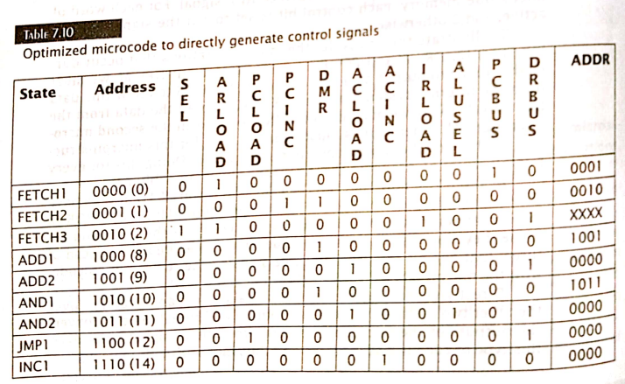
5.6 Reducing the number of micro-instructions

Slide 33
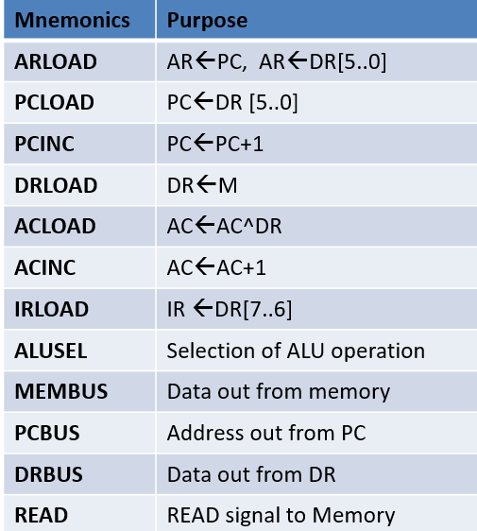
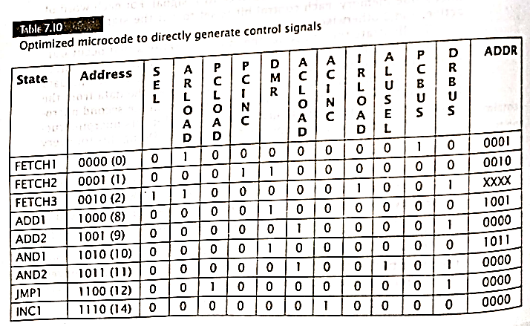
Summary:
2. Let us assume the mnemonics for all the control required in the register section as:
4. Here, for all the states, DRBUS, MEMBUS and READ have the same value. So, we can combine these three control signals to a single menmonic as DMR.
The optimized directly generated microcodes for our CPU stored in Microcode memory is:
1. The register section and RTL code for each state are:
3. The directly generated microcodes for our CPU stored in Microcode memory is:
5. The logic implementation of our required micro-sequencer Control Unit with Directly generated microcode is as below:

Slide 34
Mnemonics | Purpose
ARLOAD | AR←PC, AR←DR[5..0]
PCLOAD | PC←DR [5..0]
PCINC | PC←PC+1
DRLOAD | DR←M
ACLOAD | AC←AC^DR
ACINC | AC←AC+1
IRLOAD | IR ←DR[7..6]
ALUSEL | Selection of ALU operation
MEMBUS | Data out from memory
PCBUS | Address out from PC
DRBUS | Data out from DR
READ | READ signal to Memory

Slide 35
5.8 Micro-programmed Vs Hardwired Control Unit
 | Hardwired |  | Micro-programmed
1. | Uses flags, decoder, logic gates and other digital circuits | 1. | Uses sequence of micro-instruction in micro-programming language
2. | As name implies, it is a hardware control unit. | 2. | It is midway between Hardware and software.
3. | On the basis of input signal, output is generated. | 3. | It generates a set of control signal on the basis of control line.
4. | Difficult to design, test and implement. | 4. | Easy to design and implement
5. | Inflexible to modify | 5. | Flexible to modify
6. | Faster mode of operation | 6. | Slower mode of operation
7. | Expensive and high error | 7. | Cheaper and less error
8. | Used in RISC processor | 8. | Used in CISC processor

Slide 36
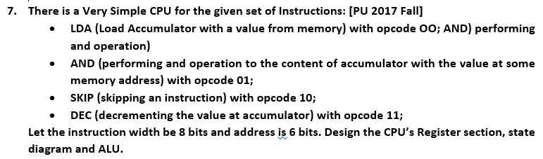
Exam questions:
Design a microsequencer control unit with horizontal microcode for the CPU described in question 7 (i.e. above question). [PU 2017 Fall]

Slide 37
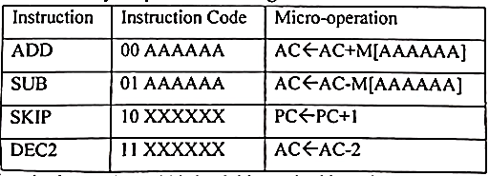
7. There is a very simple CPU for the given set of Instruction: [PU 2017 Spring]
Let the instruction width be 8 bits and address is 6 bits. Design the CPU’s register section, state diagram and ALU.
2. Design a microsequencer control unit which directly generate control signals for the CPU described in question 7 (Above question) . [PU 2017 Spring]

Slide 38
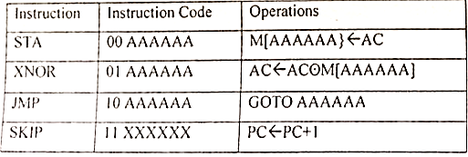
7. There is a very simple CPU for the given set of Instruction: [PU 2018 Fall]
Let the instruction width be 8 bits and address is 6 bits. Design the CPU’s register section, state diagram and ALU.
3. Design a microsequencer control unit with horizontal microcode for the CPU described in question 7 (above question) [PU 2018 Fall]

Slide 39
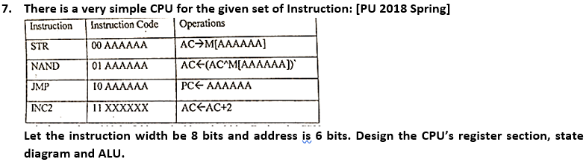
4. Design a microsequencer control unit with horizontal microcode for the CPU described in question 7. [PU 2018 Spring]

Slide 40
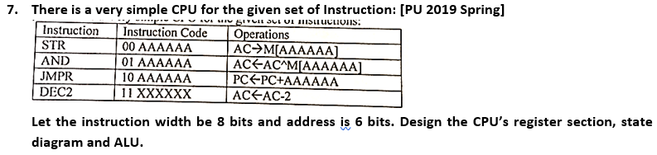
5. Design a microsequencer control unit with horizontal microcode for the CPU described in question 7. [PU 2019 Spring]

Slide 41
End of chapter 5

